Slide 1
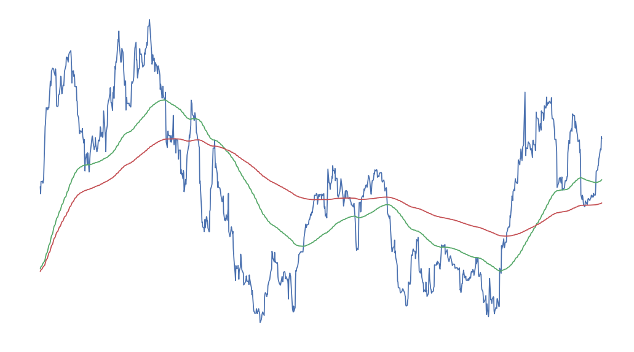
Mortgage Hedging using Kalman Filters
Presented by: Xinhui Gu, Xiaoyi Li, Jie Sheng, Weishen Wang, Guyu Xue

Slide 2
Agenda
Motivation
Data
Models
Linear Regression
Kalman Filter
Hedging Results
Measurement of Performance
Further Study
Conclusion

Slide 3
Motivation

Slide 4
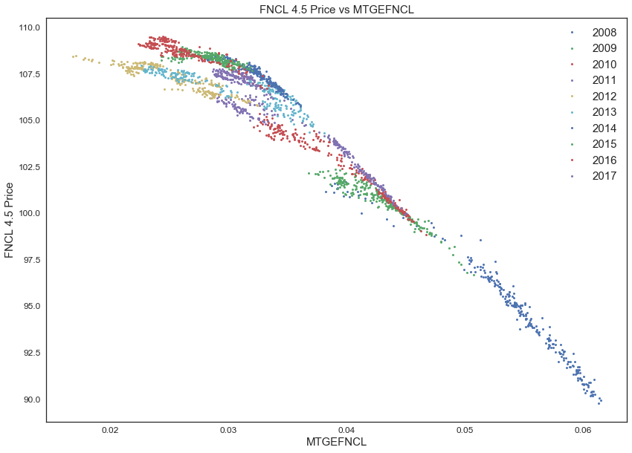


Motivation
Time Varying Duration
Diverged Prices
Price – Rate relationship is not consistent due to other macro factors that affect price
Convexity
Price – Rate relationship is not linear when the rate is low due to prepayment

Slide 5

Motivation
Time Varying Duration
Write it here
Rolling Linear Regression
Most popular and intuitive method for local fitting
Rolling Polynomial Regression
To capture the curvature in between price and rate
Kalman Filter
A popular smoothing method in financial industry
A dynamic method to capture the curvature in duration when hedging
Explore its application in pairs trading

Slide 6
Data

Slide 7
Data
TBAs
Price and insurance volume for different TBAs coupon
Reference Rate
MTGFNCL(Mortgage-Backed Securities FNMA 30-Year Index)
Hedging Instruments
Daily return of 10 year Future
*All above data are downloaded from Bloomberg
Write it here

Slide 8
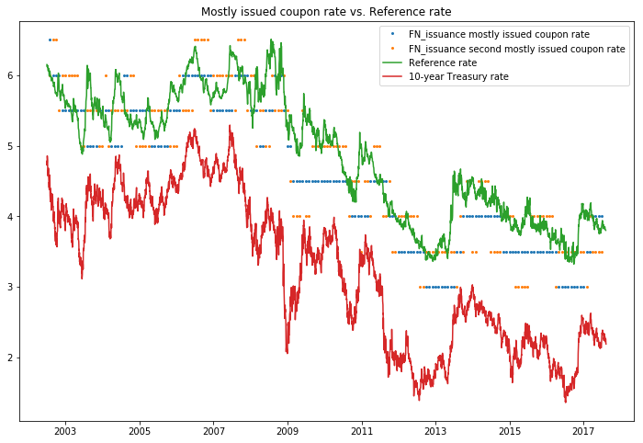
Issuance
Data Quality Assurance
Issuance volume is closely related to reference rate and 10-year treasury rate
Price is not reliable for coupons which have low issuances volumes
Focus on estimating duration and hedging for most issued TBAs
Write it here

Slide 9
Models

Slide 10
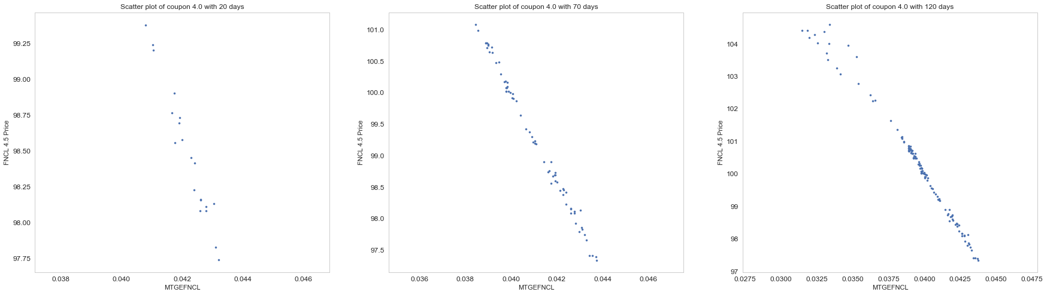
Linear Regression
With Rolling Window
With increase length of rolling window, the curvature start to appear
Fit linear regression for short window and higher order linear regression for long window

Slide 11
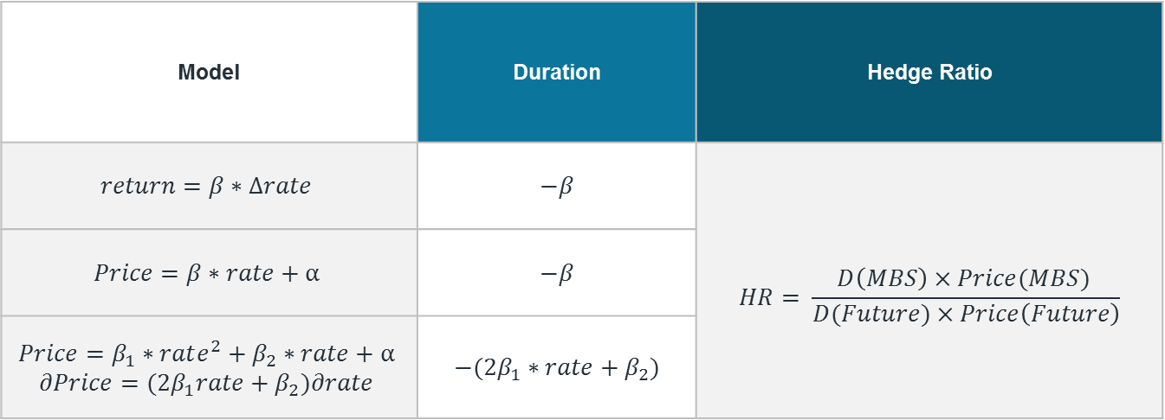
Linear Regression
With Rolling Window
Model | Duration | Hedge Ratio
$$return=β∗Δrate$$ | $$−β$$ | $$HR= \frac{D\left(MBS\right)×Price(MBS) }{D(Future)×Price\left(Future\right)}$$
$$Price=β∗rate+α$$ | $$−β$$
$$Price=β_{1}∗rate^{2}+β_{2}∗rate+α$$ $$∂Price={(2β}_{1}rate+β_{2})∂rate$$ | $$−({2β}_{1}∗rate+β_{2})$$
Write it here

Slide 12
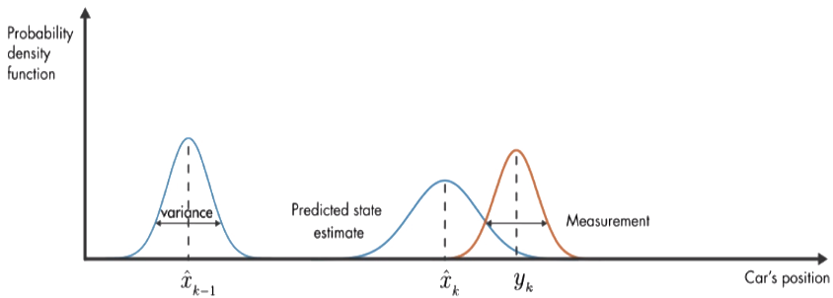
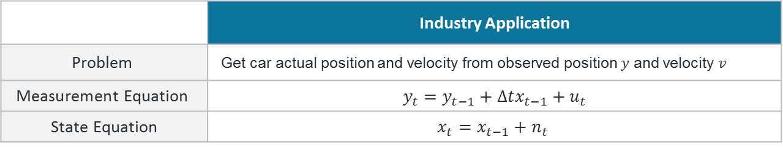


Kalman Filter
Idea Explaining
Write it here
$$n_{t} \sim N(0,σ_{n}^{2})$$
$$u_{t} \sim N(0,σ_{u}^{2})$$
 | Industry Application
$$\text{Problem}$$ | Get car actual position and velocity from observed position $y$ and velocity $v$
$$\text{Measurement} \text{Equation}$$ | $$y_{t}=y_{t−1}+Δtx_{t−1}+u_{t}$$
$\text{State} \text{Equatio}$n | $$x_{t}=x_{t−1}+n_{t}$$

Slide 13
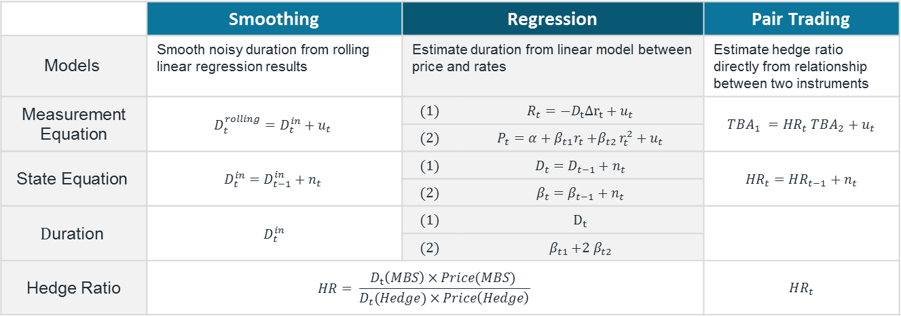
Kalman Filter
Formulation
 | Smoothing | Regression |  | Pair Trading
$$\text{M}\text{odels}$$ | Smooth noisy duration from rolling linear regression results | Estimate duration from linear model between price and rates |  | Estimate hedge ratio directly from relationship between two instruments
$\text{Measurement}$ $\text{Equation}$ | $$D_{t}^{rolling}=D_{t}^{in}+u_{t}$$ | $$(1)$$ | $$R_{t}={−D}_{t}Δr_{t}+u_{t}$$ | $$TBA_{1} =HR_{t} TBA_{2}+u_{t}$$
 |  | $$(2)$$ | $$P_{t}=α+β_{t1}r_{t}{+β}_{t2}r_{t}^{2}+u_{t}$$
$$\text{State} \text{Equation}$$ | $$D_{t}^{in}=D_{t−1}^{in}+n_{t}$$ | $$(1)$$ | $$D_{t}=D_{t−1}+n_{t}$$ | $$HR_{t}=HR_{t−1}+n_{t}$$
 |  | $$(2)$$ | $$β_{t}=β_{t−1}+n_{t}$$
$$\text{D}\text{uration}$$ | $$D_{t}^{in}$$ | $$(1)$$ | $$D_{t}$$
 |  | $$(2)$$ | $$β_{t1}{+2 β}_{t2}$$
Hedge Ratio | $$HR= \frac{D_{t}\left(MBS\right)×Price(MBS) }{D_{t}(Hedge)×Price\left(Hedge\right)}$$ |  |  | $$HR_{t}$$

Slide 14
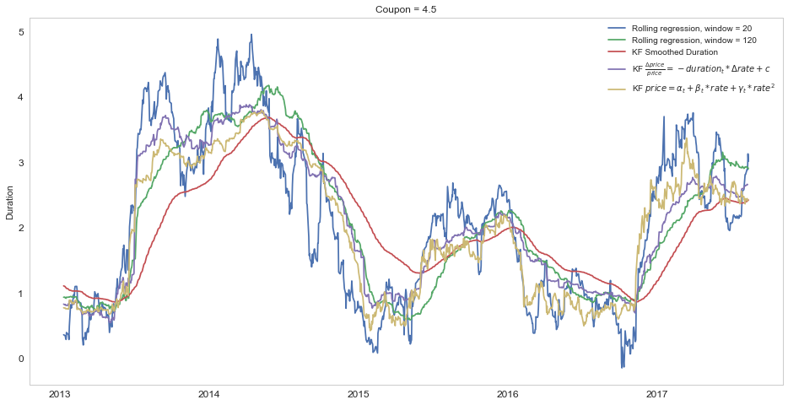
Estimated Duration
Notes:
掐头去尾

Slide 15
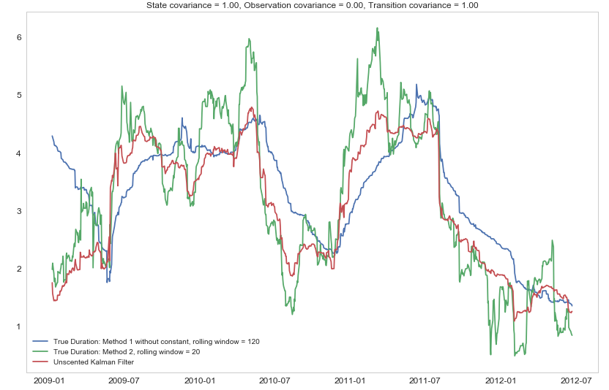
Estimated Duration
Kalman Filter of dP ~ dR, Coupon=4
Notes:
4.0 * this model + OLS + regression
4.5 * this model + OLS + regression
3.5 * this model + OLS + regression

Slide 16
Performance Measure - Hedging

Slide 17
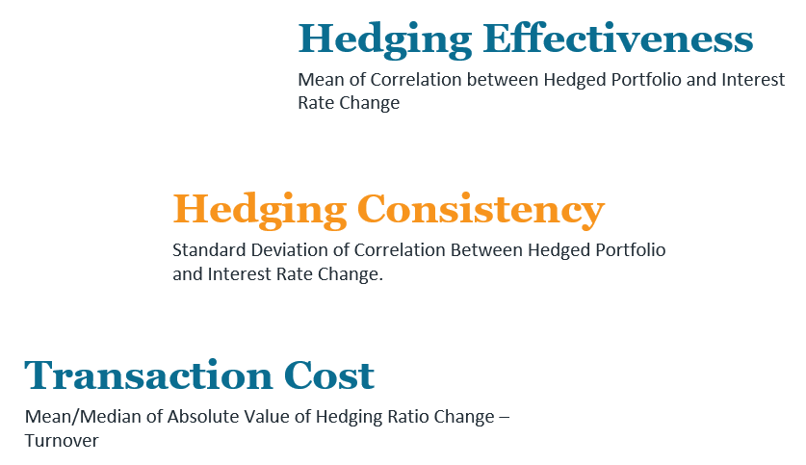
Hedging Performance
Measurement Matrix
Write it here

Slide 18
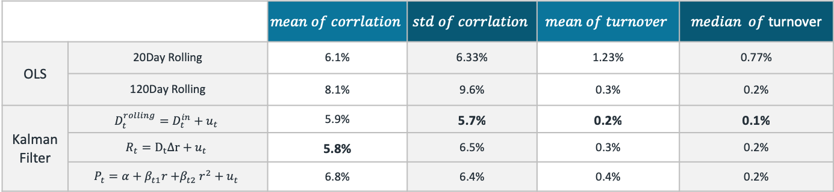
Hedging Performance
Results
 |  | $$mean of corrlation$$ | $$std of corrlation$$ | $$mean of turnover$$ | $median of$turnover
OLS | 20Day Rolling | 6.1% | 6.33% | 1.23% | 0.77%
 | 120Day Rolling | 8.1% | 9.6% | 0.3% | 0.2%
Kalman Filter | $$D_{t}^{rolling}=D_{t}^{in}+u_{t}$$ | 5.9% | 5.7% | 0.2% | 0.1%
 | $$R_{t}=D_{t}Δr+u_{t}$$ | 5.8% | 6.5% | 0.3% | 0.2%
 | $$P_{t}=α+β_{t1}r{+β}_{t2}r^{2}+u_{t}$$ | 6.8% | 6.4% | 0.4% | 0.2%
Correlation is computed against daily 10yr rate changes
Turnover is computed as abs(daily changes in hedge ratio)

Slide 19
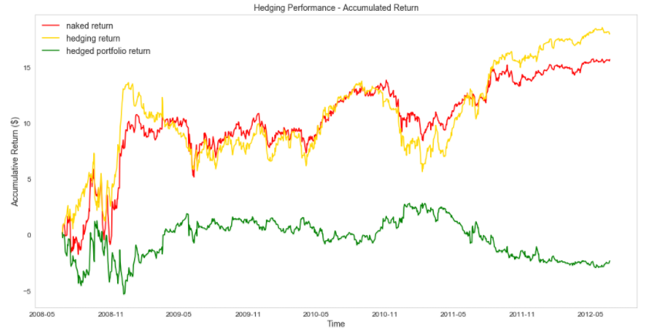
Hedging Performance
Naked return = TBA return
Hedging return = Hedge_ratio * (10y treasury future return)
Hedged portfolio return = TBA return – Hedging return
Notes:
change return quote 120 smoth 3.2

Slide 20
Further Study

Slide 21
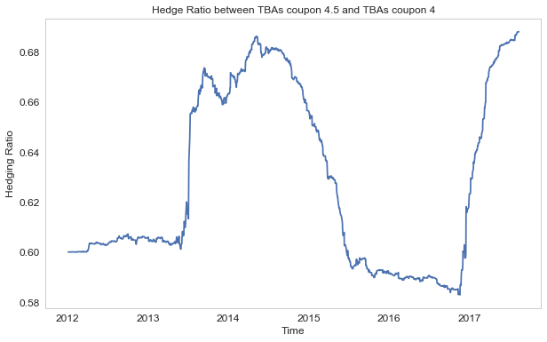
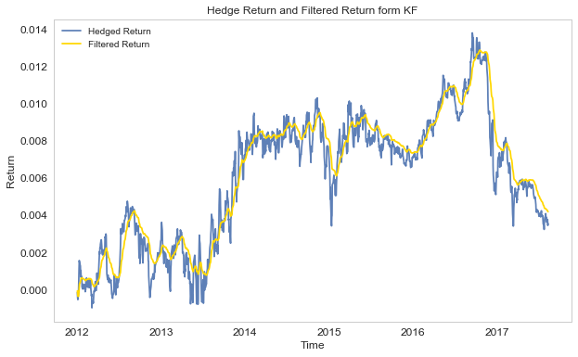
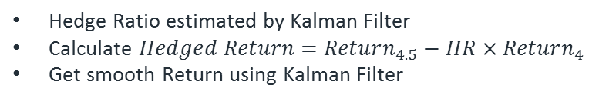
Pair Trading
Using Kalman Filter to find the Hedge Ratio and Trading Trigger
Hedge Ratio estimated by Kalman Filter
Calculate $Hedged Return=Return_{4.5}−HR×Return_{4}$
Get smooth Return using Kalman Filter

Slide 22
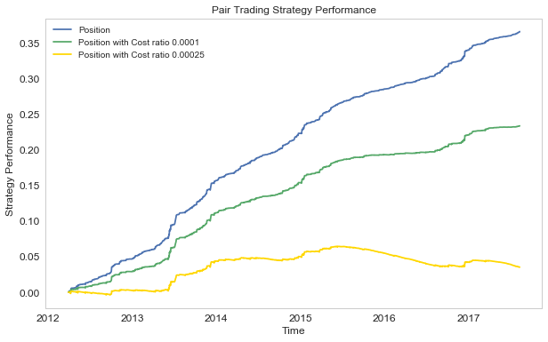
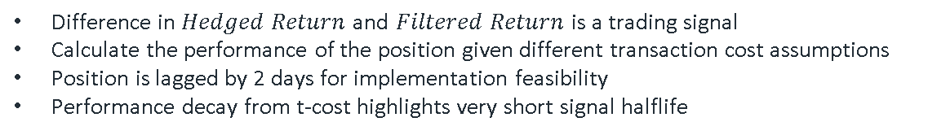
Pair Trading
Using Kalman Filter to find the Hedge Ratio and Trading Trigger
Difference in $Hedged Return$ and $Filtered Return$ is a trading signal
Calculate the performance of the position given different transaction cost assumptions
Position is lagged by 2 days for implementation feasibility
Performance decay from t-cost highlights very short signal halflife

Slide 23
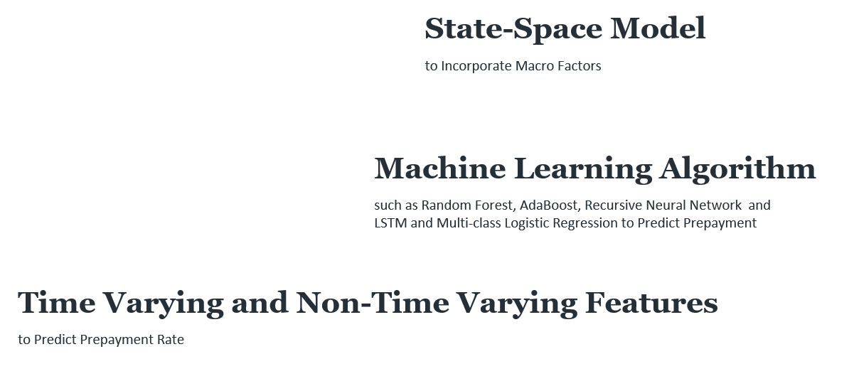
Further Study
Other Models

Slide 24
Conclusion

Slide 25
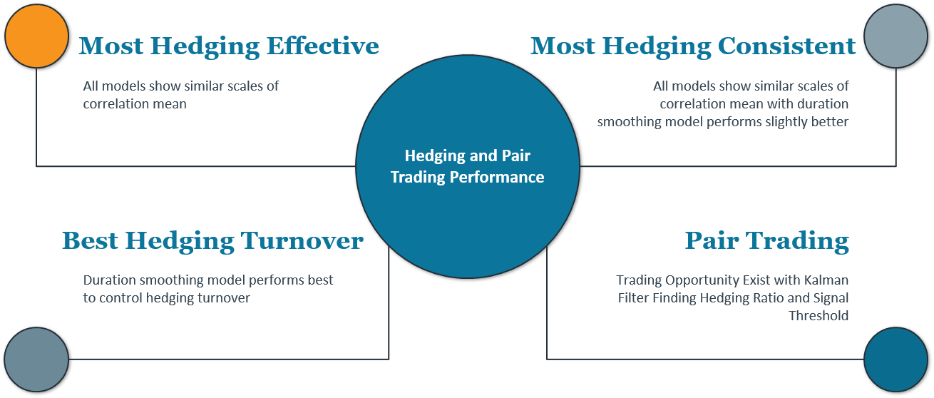
Conclusion
Notes:
TBA return -
Residual return - Mean reverting series (
Extended Kalman Filter
Recursive Neural Network [Collateroal Data]
Hedging → Pair trading?
2 Durations, hedge ratio → hedging portfolio → Residual return (Whether mean reverting?)
Test : Return. Residual return Mean = 0?
Neural Network?
Collateral data? Historical performance?
Predicting model: future duration -- long period
Q:
Prepayment prediction (ML)
performance
Features : … (High dimension)

Slide 26
Appendix

Slide 27
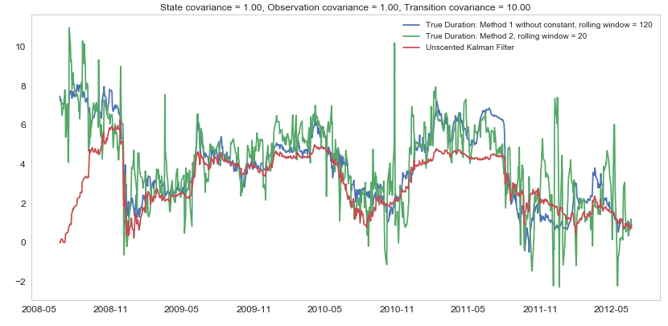

Duration Estimation
$$coupon=3.5$$

Slide 28
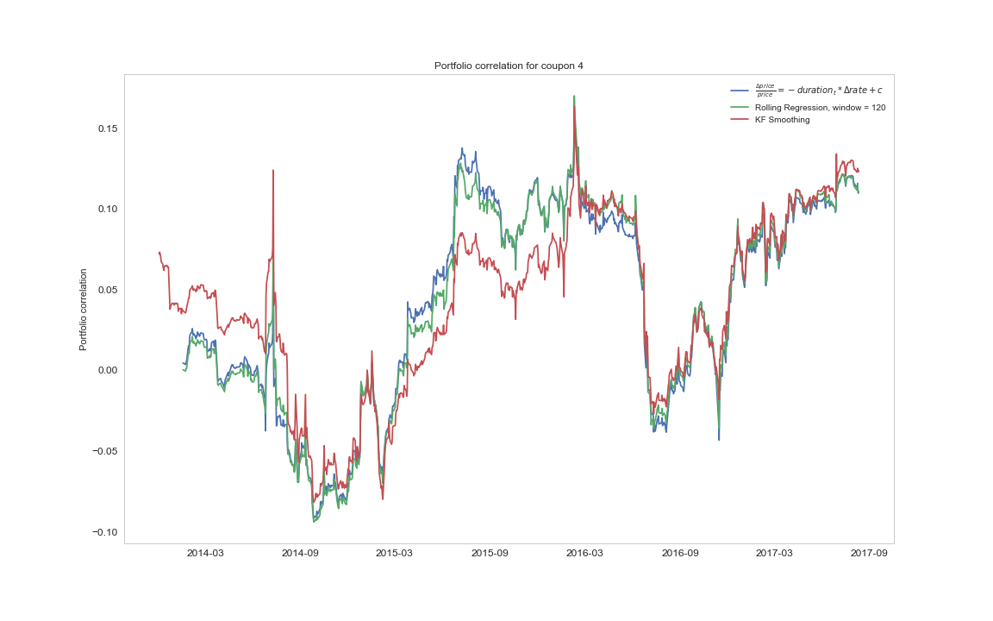
Hedging Performance
C$orrelation to 10yr rate changes, coupon=4$

Slide 29
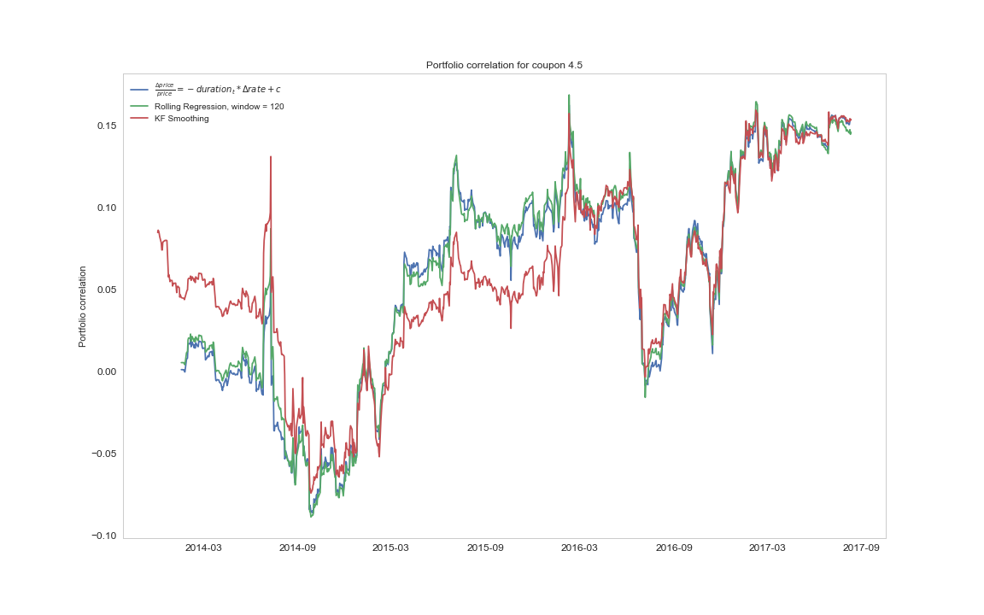
Hedging Performance
C$orrelation to 10yr rate changes, coupon=4.5$

